Slide 1
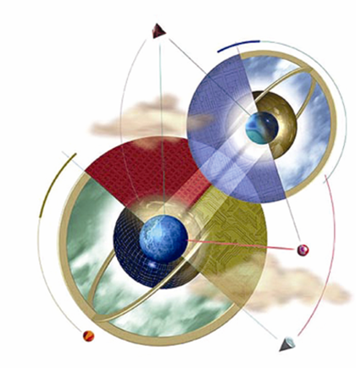
Chapter 3:
Methods of Inference
Expert Systems: Principles and Programming, Fourth Edition

Slide 2
Objectives
Learn the definitions of trees, lattices, and graphs
Learn about state and problem spaces
Learn about AND-OR trees and goals
Explore different methods and rules of inference
Learn the characteristics of first-order predicate logic and logic systems

Slide 3
Objectives
Discuss the resolution rule of inference, resolution systems, and deduction
Compare shallow and causal reasoning
How to apply resolution to first-order predicate logic
Learn the meaning of forward and backward chaining

Slide 4
Objectives
Explore additional methods of inference
Learn the meaning of Metaknowledge
Explore the Markov decision process

Slide 5
Trees
A tree is a hierarchical data structure consisting of:
  Nodes – store information
  Branches – connect the nodes
The top node is the root, occupying the highest hierarchy.
The leaves are at the bottom, occupying the lowest hierarcy.

Slide 6
Trees
Every node, except the root, has exactly one parent.
Every node may give rise to zero or more child nodes.
A binary tree restricts the number of children per node to a maximum of two.
Degenerate trees have only a single pathway from root to its one leaf.

Slide 7
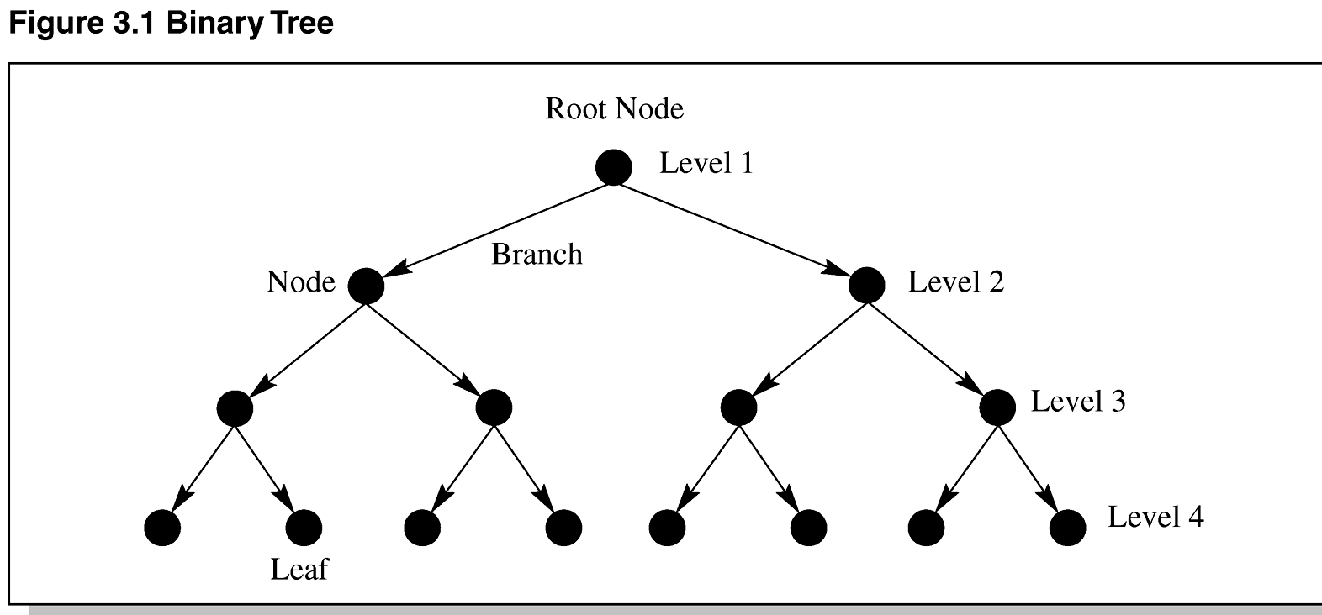
Figure 3.1 Binary Tree

Slide 8
Graphs
Graphs are sometimes called a network or net.
A graph can have zero or more links between nodes – there is no distinction between parent and child.
Sometimes links have weights – weighted graph; or, arrows – directed graph.
Simple graphs have no loops – links that come back onto the node itself.

Slide 9
Graphs
A circuit (cycle) is a path through the graph beginning and ending with the same node.
Acyclic graphs have no cycles.
Connected graphs have links to all the nodes.
Digraphs are graphs with directed links.
Lattice is a directed acyclic graph.

Slide 10
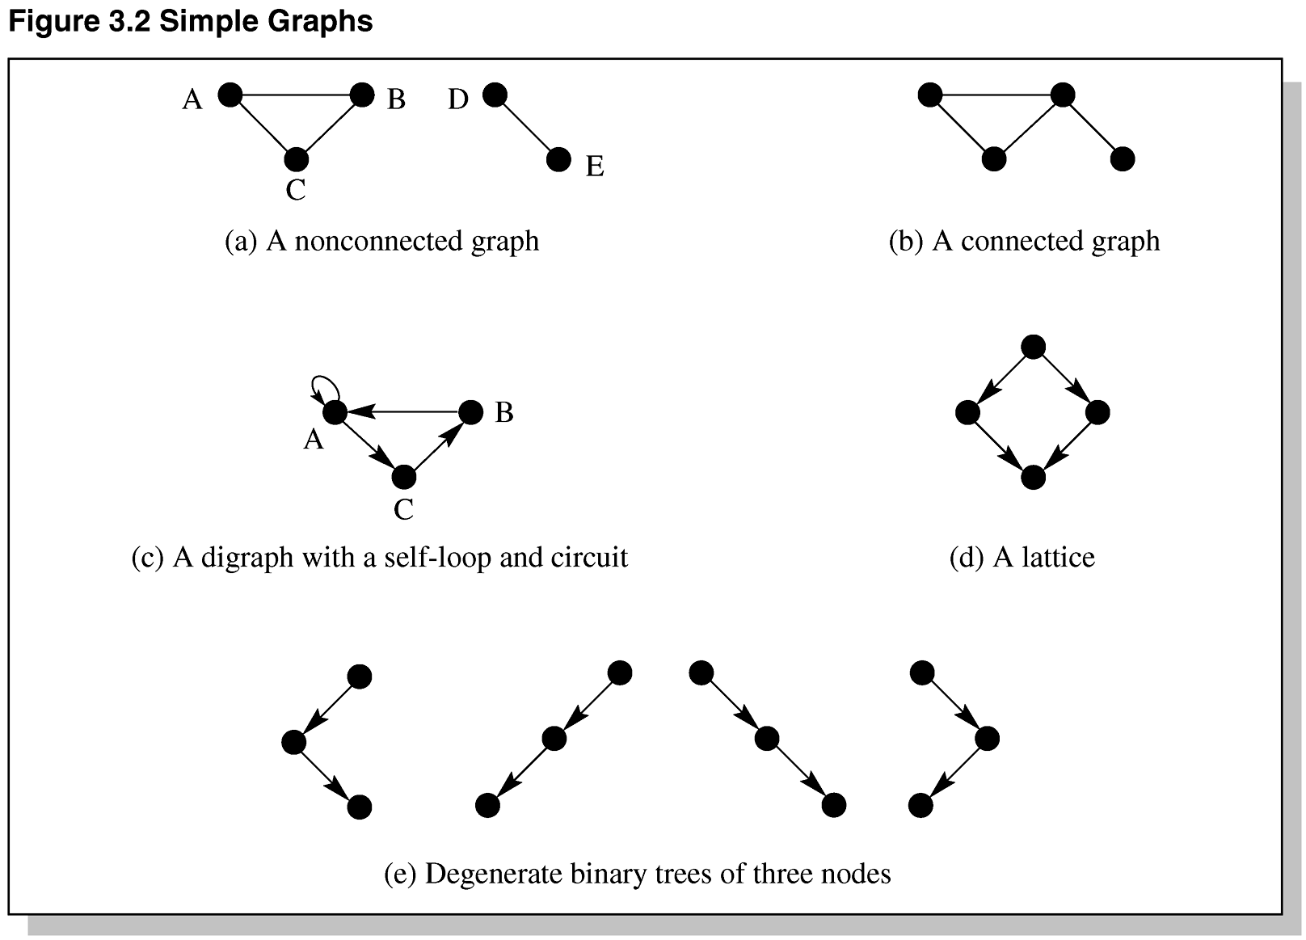
Figure 3.2 Simple Graphs

Slide 11
Making Decisions
Trees / lattices are useful for classifying objects in a hierarchical nature.
Trees / lattices are useful for making decisions.
We refer to trees / lattices as structures.
Decision trees are useful for representing and reasoning about knowledge.

Slide 12
Binary Decision Trees
Every question takes us down one level in the tree.
A binary decision tree having N nodes:
  All leaves will be answers.
  All internal nodes are questions.
  There will be a maximum of 2^{N} answers for N questions.
Decision trees can be self learning.
Decision trees can be translated into production rules.

Slide 13
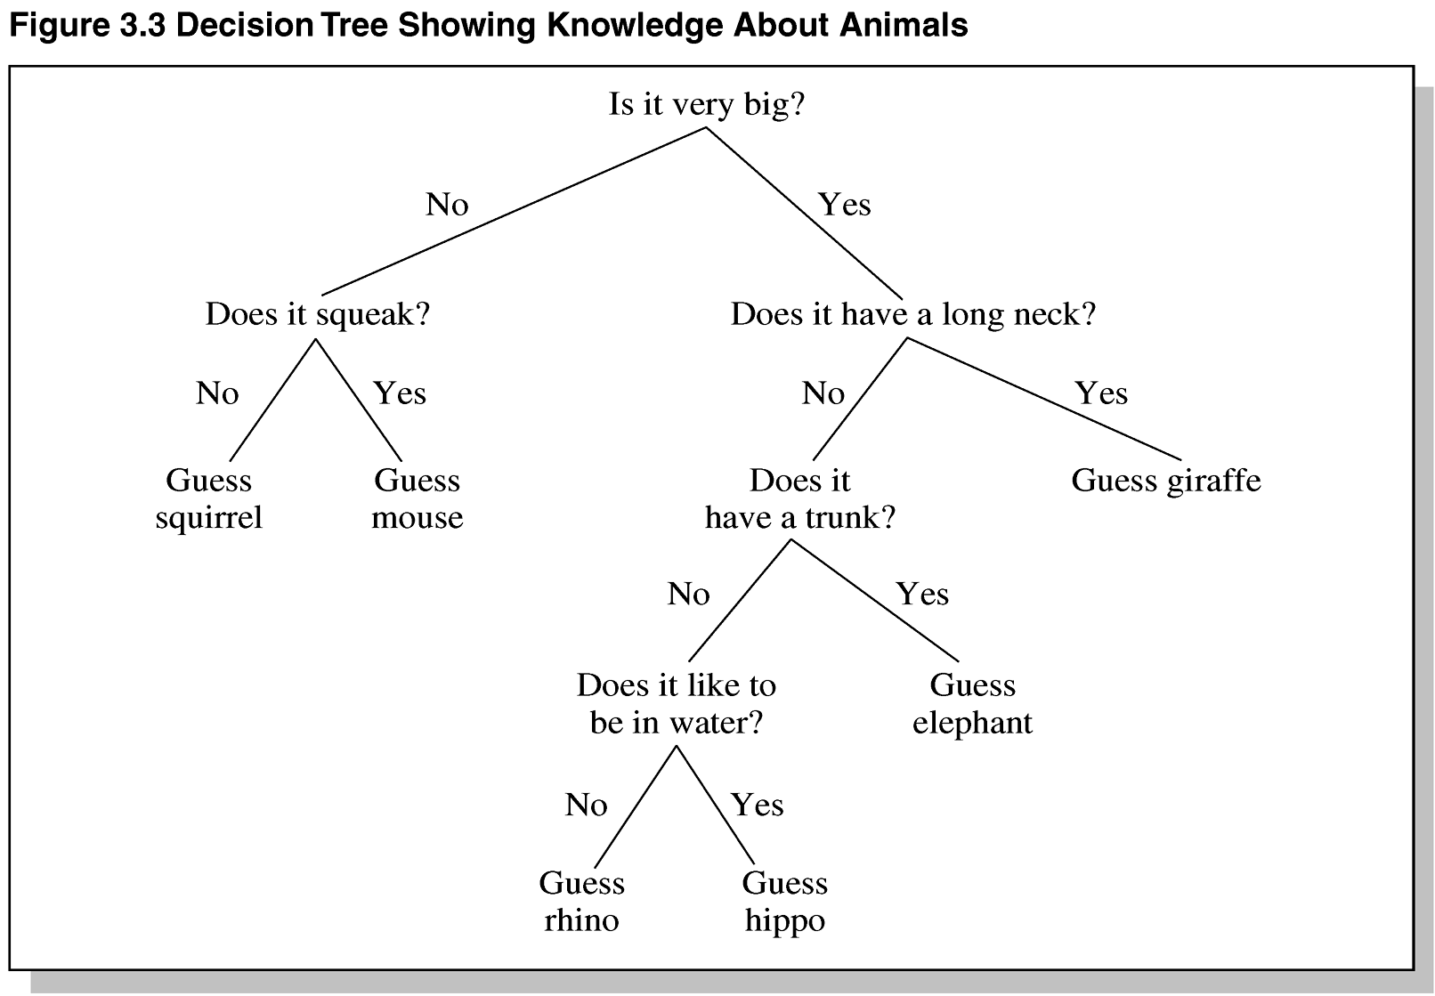
Decision Tree Example

Slide 14
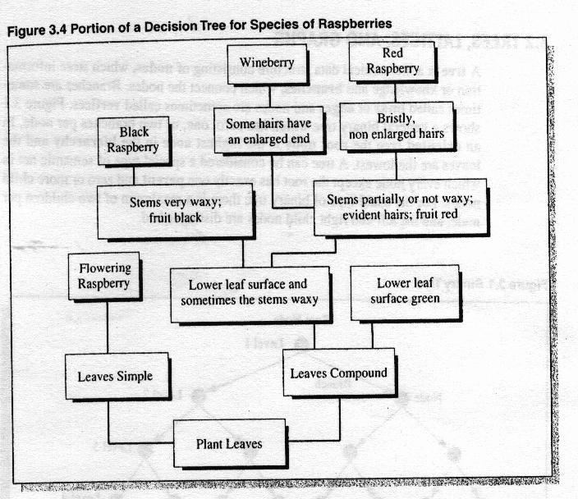
Decision Tree Example

Slide 15
State and Problem Spaces
A state space can be used to define an object’s behavior.
Different states refer to characteristics that define the status of the object.
A state space shows the transitions an object can make in going from one state to another.

Slide 16
Finite State Machine
A FSM is a diagram describing the finite number of states of a machine.
At any one time, the machine is in one particular state.
The machine accepts input and progresses to the next state.
FSMs are often used in compilers and validity checking programs.

Slide 17
Using FSM to Solve Problems
Characterizing ill-structured problems – one having uncertainties.
Well-formed problems:
  Explicit problem, goal, and operations are known
  Deterministic – we are sure of the next state when an operator is applied to a state.
  The problem space is bounded.
  The states are discrete.

Slide 18
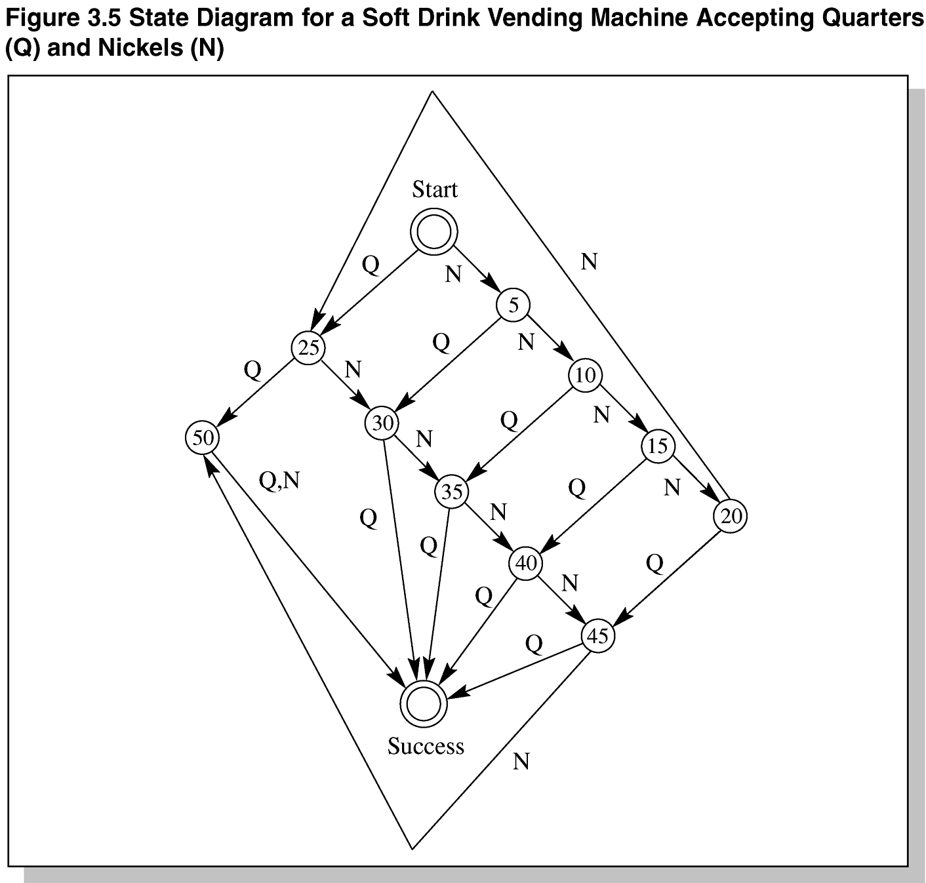
Figure 3.5 State Diagram for a Soft Drink Vending Machine Accepting Quarters (Q) and Nickels (N)

Slide 19
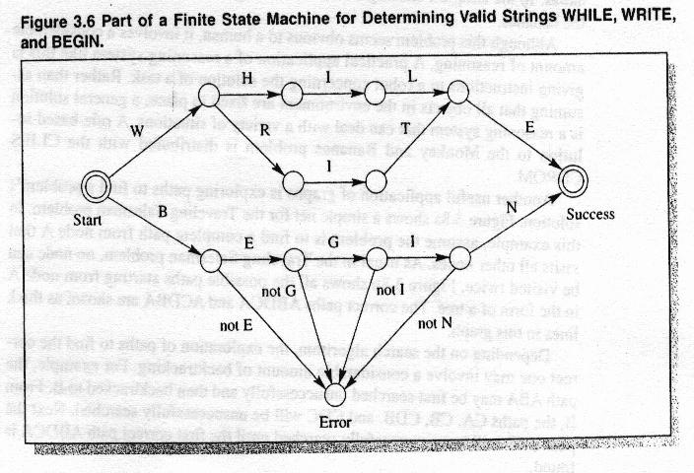

Slide 20
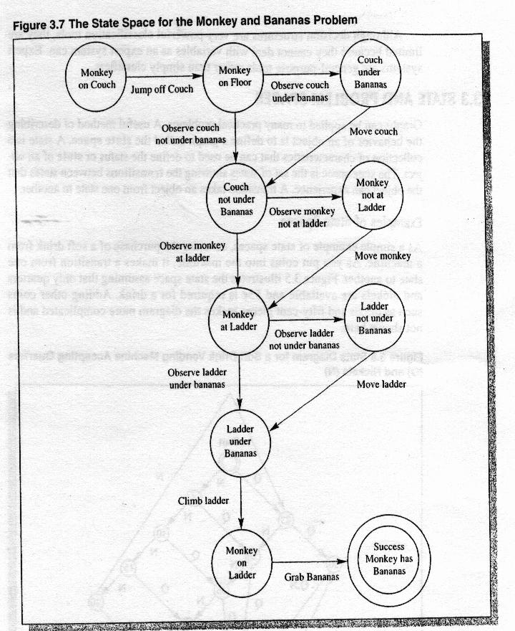

Slide 21
AND-OR Trees and Goals
1990s, PROLOG was used for commercial applications in business and industry.
PROLOG uses backward chaining to divide problems into smaller problems and then solves them.
AND-OR trees also use backward chaining.
AND-OR-NOT lattices use logic gates to describe problems.

Slide 22
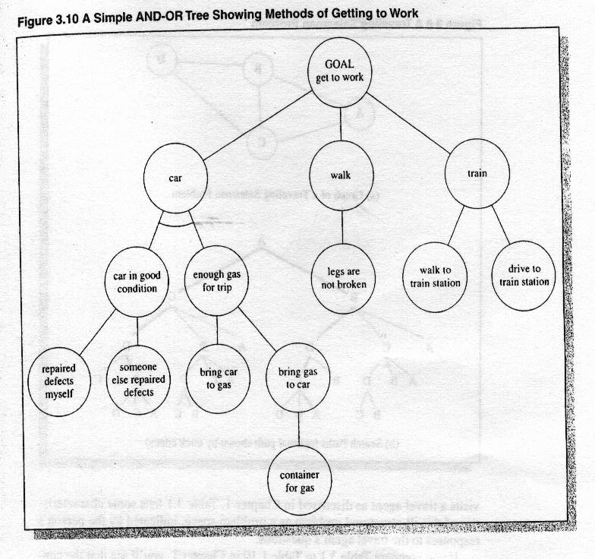
AND-OR Trees and Goals

Slide 23
Types of Logic
Deduction – reasoning where conclusions must follow from premises
Induction – inference is from the specific case to the general
Analogy – inferring conclusions based on similarities with other situations
Abduction – reasoning back from a true condition to the premises that may have caused the condition

Slide 24
Types of Logic
Default – absence of specific knowledge
Autoepistemic – self-knowledge
Intuition – no proven theory
Heuristics – rules of thumb based on experience
Generate and test – trial and error

Slide 25
Deductive Logic
Argument – group of statements where the last is justified on the basis of the previous ones
Deductive logic can determine the validity of an argument.
Syllogism – has two premises and one conclusion
Deductive argument – conclusions reached by following true premises must themselves be true

Slide 26
Syllogisms vs. Rules
Syllogism:
  All basketball players are tall.
  Jason is a basketball player.
   Jason is tall.
IF-THEN rule:
  IF All basketball players are tall and
  Jason is a basketball player
  THEN Jason is tall.

Slide 27
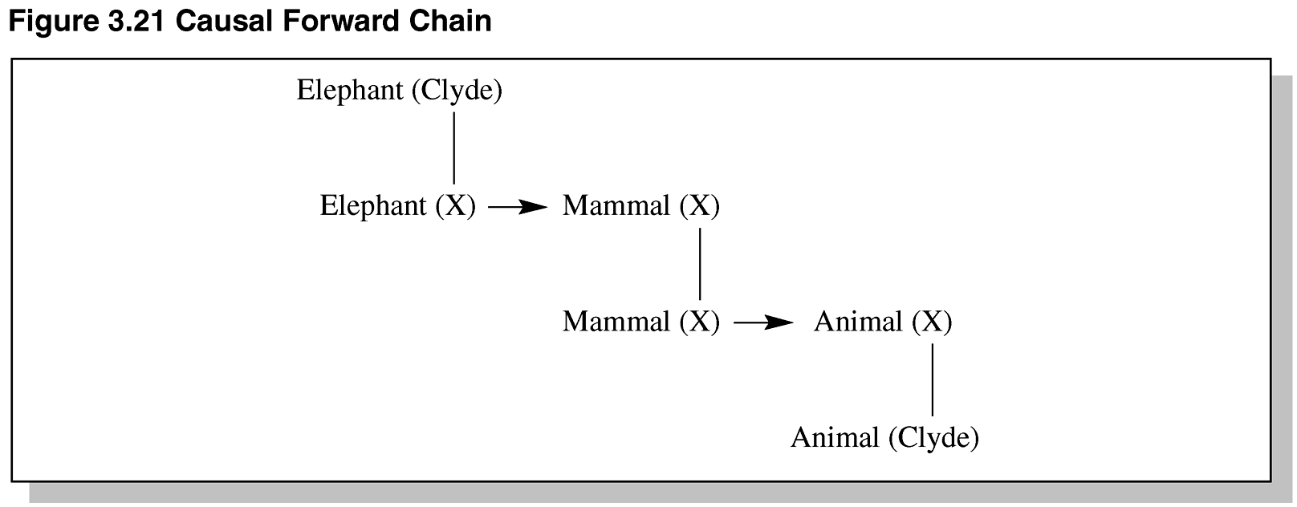
Figure 3.21 Causal Forward Chaining

